Slide 1

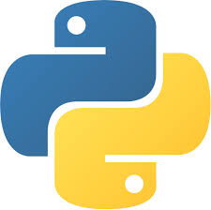

AI Master Class series – Day 30
AI Hardware

Slide 2
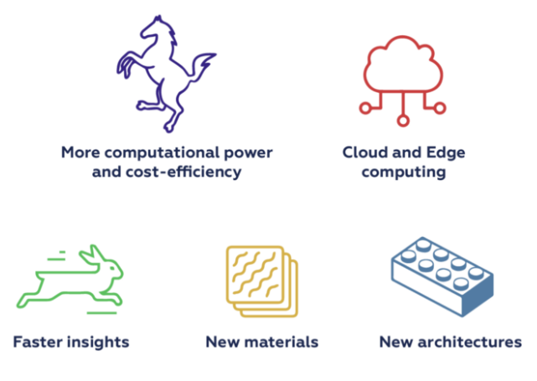
AI Hardware
AI accelerators are a class of microprocessors, or microchips, designed to enable faster processing of AI applications, especially in machine learning, neural networks and computer vision.
They are usually designed as many core and focus on low-precision arithmetic, novel dataflow architectures or in-memory computing capability.
CPU – Central Processing Units
GPU – Graphics Processing Units
FPGA – Field Programmable Gate Arrays
ASIC – Application Specific Integrated Circuits

Slide 3
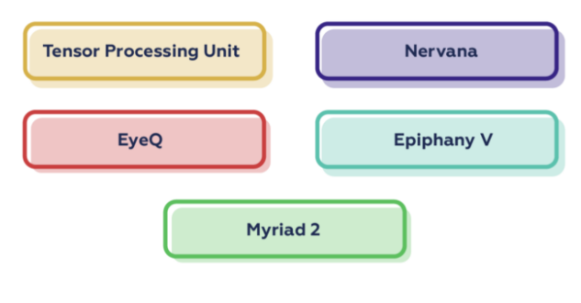
Popular AI Hardware Solutions
TPU - AI accelerator application-specific integrated circuit (ASIC) developed by Google specifically for neural network machine learning which features a cloud solution.
Nervana - Neural Network Processor-I 1000 is a discrete accelerator produced by Intel that is designed specifically for the growing complexity and scale of inference application.
EyeQ – it is of a family of system-on-chip (SoC) devices that are designed by Mobileye to support complex and computationally intense vision processing, maintaining low power consumption even while located on the windshield.

Slide 4
Popular AI Hardware Solutions
Epiphany V – It is a 1,024-core processor chip by Adapteva aimed at real-time image processing, autonomous driving, and machine learning.
Myriad 2 - is a vision processor unit (VPU) system-on-a-chip (SoC) by Movidus comprises a set of programmable processors and a set of dedicated and configurable image and vision accelerators to power computational cameras.

Slide 5
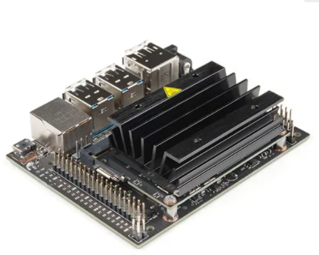
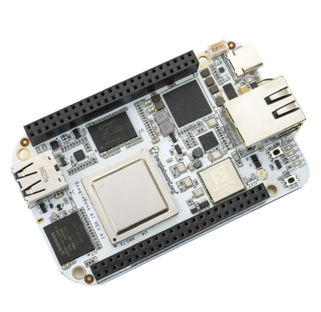
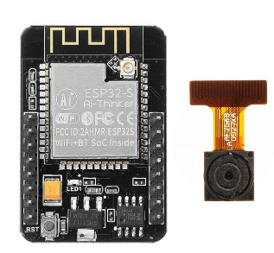
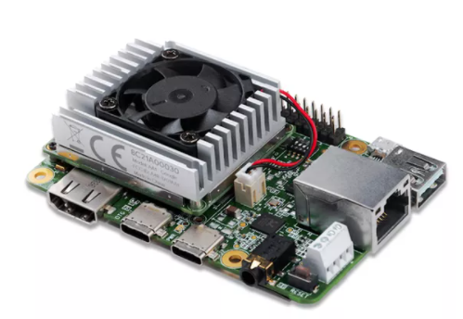
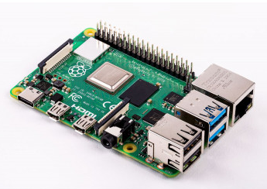
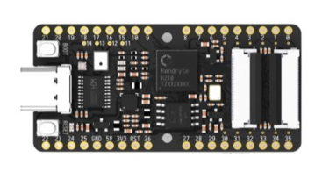
Dev. Boards for AI
NVidia Jetson Nano – RS: 14,000
BeagleBone AI Fast Track– RS: 10,000
Ai Thinker ESP32– RS: 842
Sipeed MAix BiT for RISC-V– RS: 2000
Coral Dev Board– RS: 16000
Raspberry Pi 4– RS: 3000

Slide 6
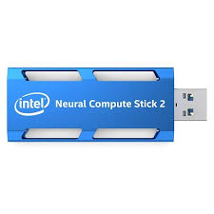
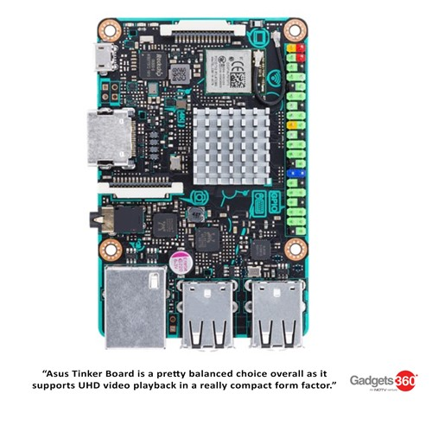
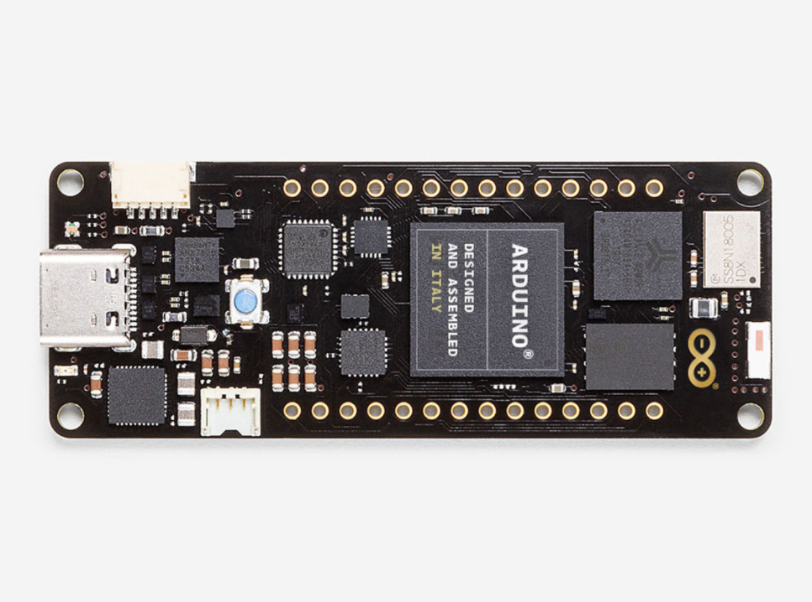
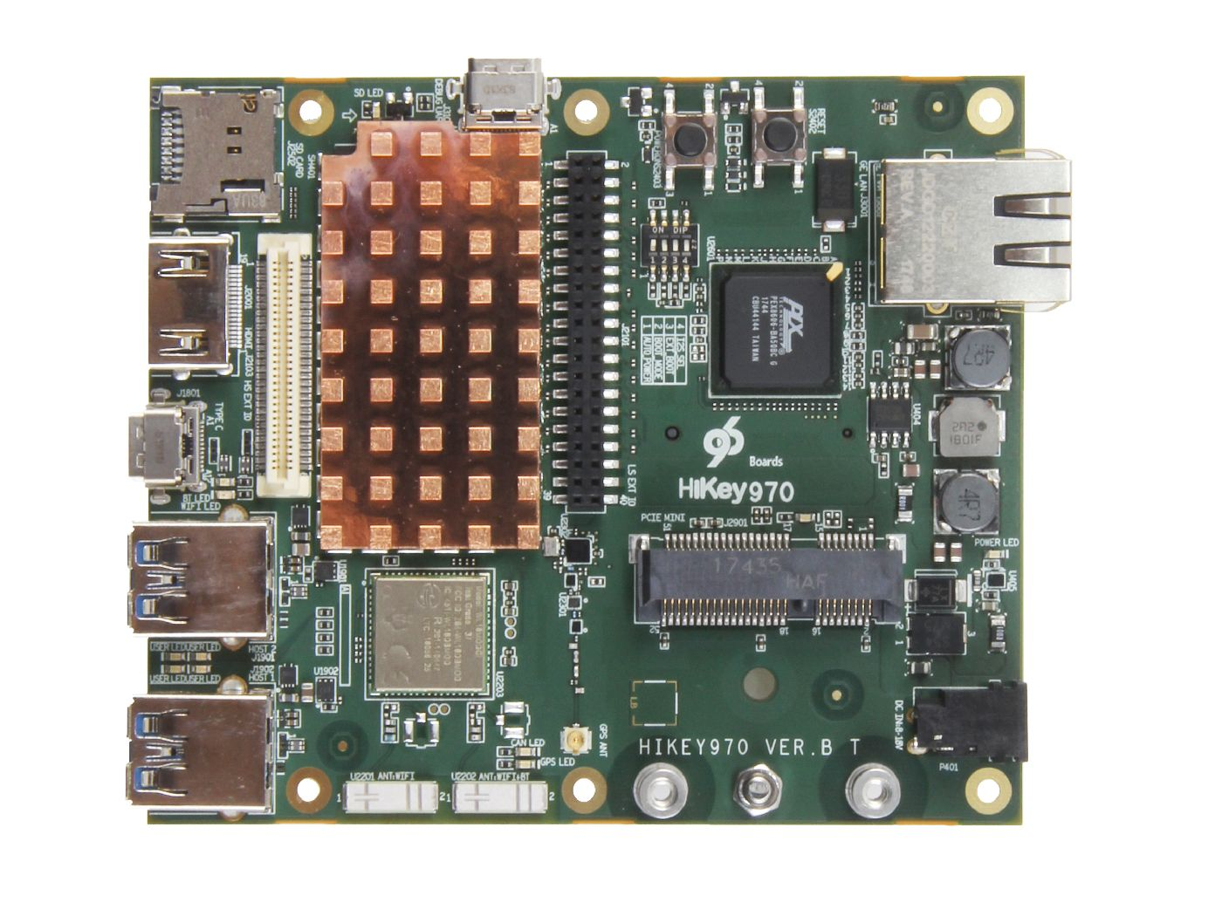
Dev. Boards for AI
Neual Compute Stick– RS: 10,000
Arduino Portenta H7– RS: 10,500
Asus Tinker Board– RS: 5,500
HIKEY 970 development Bords– RS: 22,500

Slide 7
Best Performance / Wattage: Coral DevBoard
Best Flexibility: Jetson Nano
Cheapest: Sipeed MAIX GO
Best Support: Raspberry Pi 4
Alternative for Raspberry Pi 4: ROCK Pi 4 Model B

Slide 8

! PRACTICAL SESSION !

Slide 9
Overview on FPGA with Python ZYNQ | PYNQ – Z2

Slide 10
Object Recognition using Raspberry Pi & Raspberry Pi With NCS 2
PERFORMANCE COMPARISION

Slide 11

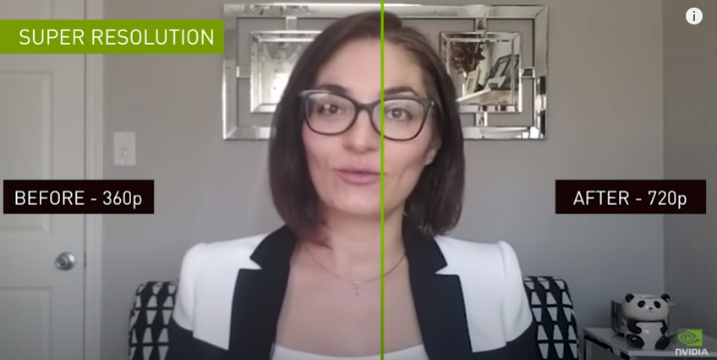
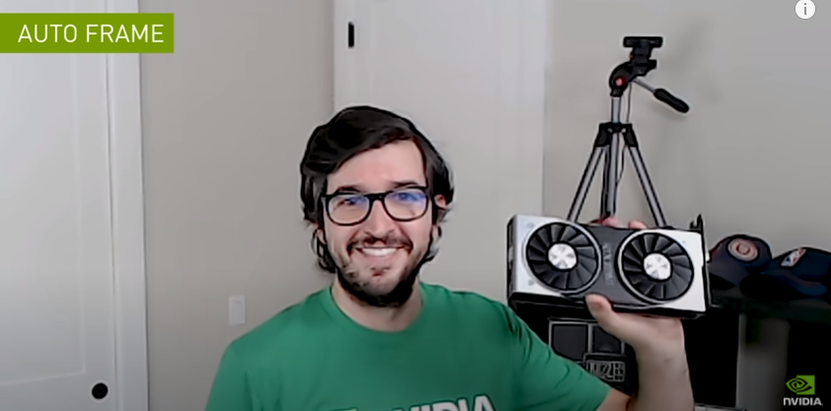

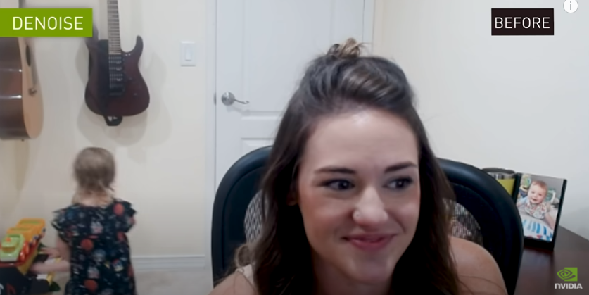
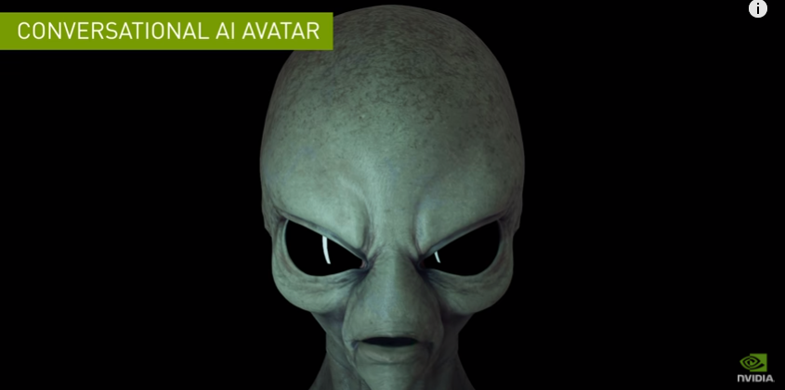
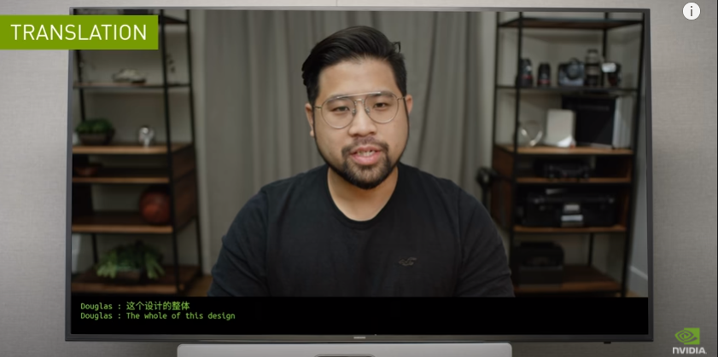
AI News – Day 30. OCT - 2020

Slide 12
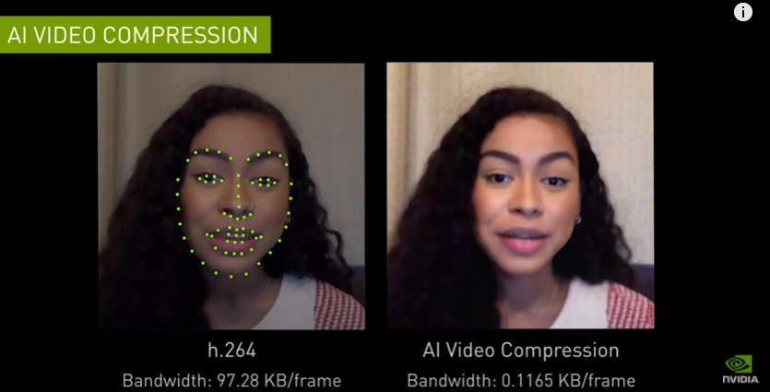
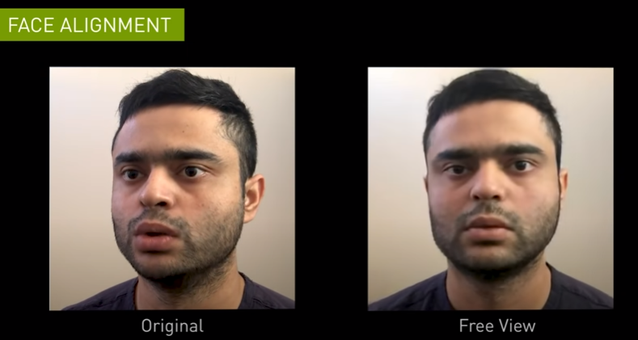
AI News – Day 30. OCT - 2020

Slide 13
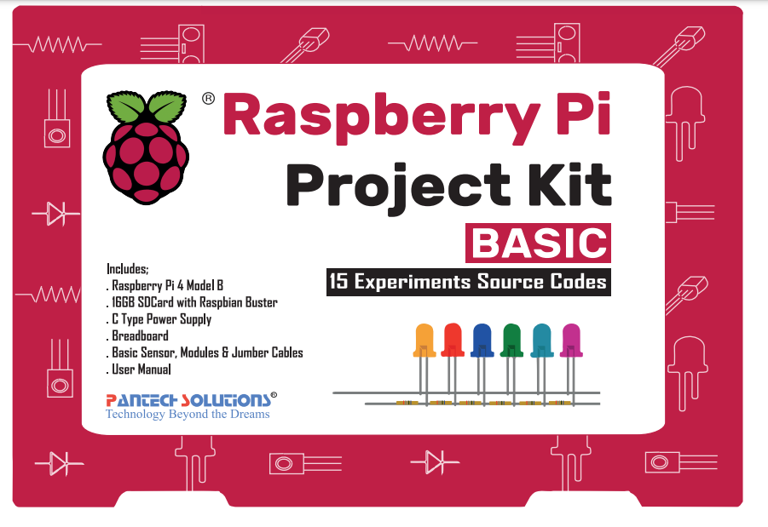
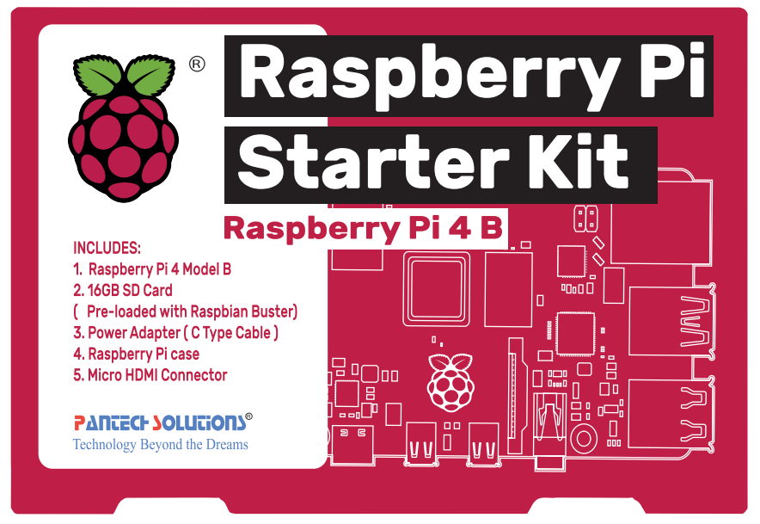
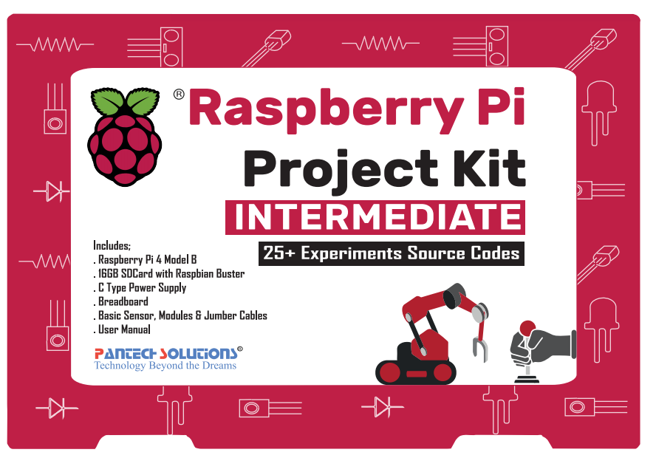
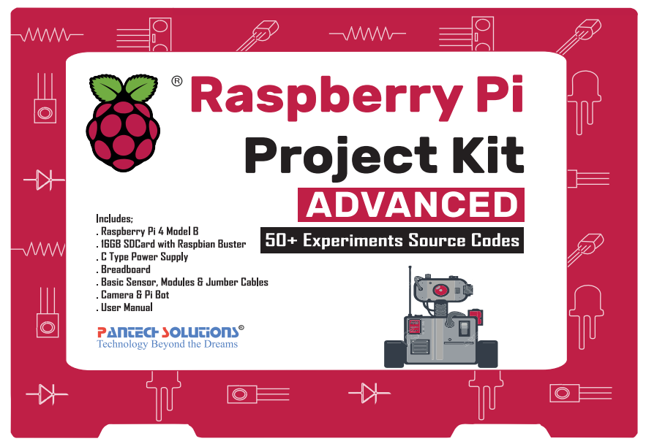
Pantech’s Raspberry Pi DIY Kit – Product List

Slide 14
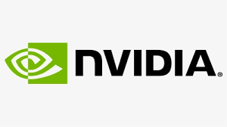

Nvidia Jetson Nano Starter Kit Nvidia Jetson Nano Bot Complete Kit FPGA with Python Starter Kit – PYNQ – Z2
Pantech’s Jetson & PYNQ FPGA DIY Kit – Product List

Slide 15
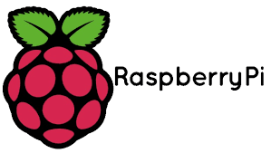
Raspberry Pi Complete Kit Raspberry Pi Project Kit | Basic | 10 Experiment Raspberry Pi Project Kit | Intermediate | 25 Experiment Raspberry Pi Project Kit | Advanced | 50 Experiment Raspberry Pi IoT Kit | 25 Experiment Raspberry Pi ROS Kit Raspberry Pi Deep learning Kit Raspberry Pi Chatbot Kit Raspberry Pi Robotics Kit Raspberry Pi BCI Kit Raspberry Pi Electrical Kit Raspberry Pi Zero Starter kit Raspberry Pi tensorflow kit
Pantech’s Raspberry Pi DIY Kit – Product List

Slide 16
Thanks!
Follow me on LinkedIn
https://www.linkedin.com/in/sanjay-kumar-a-p-4447801a5/
Visit
www.pantechsolutions.net

Slide 17
Day-30 Agenda.
01.
02.
03.
AI Hardware
List of Dev. boards for AI
Performance Comparision Rpi vs Rpi with NCS2
04.
Q & A

